Slide 1

VOLTORB OCTOBER 2021
TILT BASED SPEED CONTROL SYSTEM FOR AN AIRCRAFT
IEEE UVCE PES

Slide 2

PROBLEM STATEMENT
You are in charge of the development of control systems for an aircraft company. The aircraft has a propeller whose speed can be controlled using a knob. You are required to build an intelligent system that will help avoid a crash. In any aircraft, during its climb i.e when the nose is up, the speed of the propeller must be above the lower threshold RPM in order to maintain a good ascend velocity. When the nose is down, the speed of the propeller must be lower than the upper threshold RPM to avoid excess speed during the descent that will make the aircraft uncontrollable.
Build a system that has the following functionalities:
1.When the nose of the aircraft is at level, the speed of the propeller increases in accordingly with the knob and vice versa.
2. When the nose is up, the speed of the propeller shouldn't fall below the lower threshold RPM even when the knob is rotated down to zero.
3.When the nose is down, the speed of the propeller shouldn't go above the higher threshold RPM even when the knob is rotated to the fullest.

Slide 3

COMPONENTS REQUIRED
Microcontroller - Arduino Uno
DC Motor
Potentiometer - Knob
Tilt Switch / Sensor (2)
Motor Driver IC - L293D
Breadboard & connecting wires

Slide 4
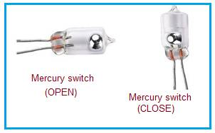
TILT SWITCH
A Tilt Switch is used to detect if the aircraft is tilted upwards or downwards.
In this project, we will be using two tilt switches where one will detect upward tilt and another detects downward tilt.
A Tilt Switch is sometimes also called as Mercury Switch since it has a movable mercury ball, that when touches the filament, the circuit gets closed and vice versa.
Note: A Tilt Switch is a digital sensor i.e it outputs either HIGH or LOW. Unlike a Tilt Sensor, which is an analog sensor that outputs the degree of tilt.

Slide 5
LOGIC FLOWCHART
FALSE
FALSE
if LEVEL
if UPTILT
if DOWNTILT
FALSE
TRUE
TRUE
TRUE
Speed Varies linearly with the Knob & doesn’t fall below the lower threshold
Speed Varies linearly with the Knob & doesn’t rise above the upper threshold.
Speed Varies linearly with the Knob

Slide 6
PROCEDURE
Connect the two tilt switches with the Microcontroller(Arduino).
The output of the tilt switches is as follows:
AT-LEVEL : UpSensor = 1 && DownSensor =1
UP-TILT : UpSensor = 0 && DownSensor =1
DOWN-TILT : UpSensor = 1 && DownSensor = 0
Note: 1. The Sensor outputs LOW(0) , if there is a tilt.
2. It is practically not possible to have LOW(0) outputs from both the sensors , since an aircraft can’t be tilted upwards and downwards simultaneously.

Slide 7
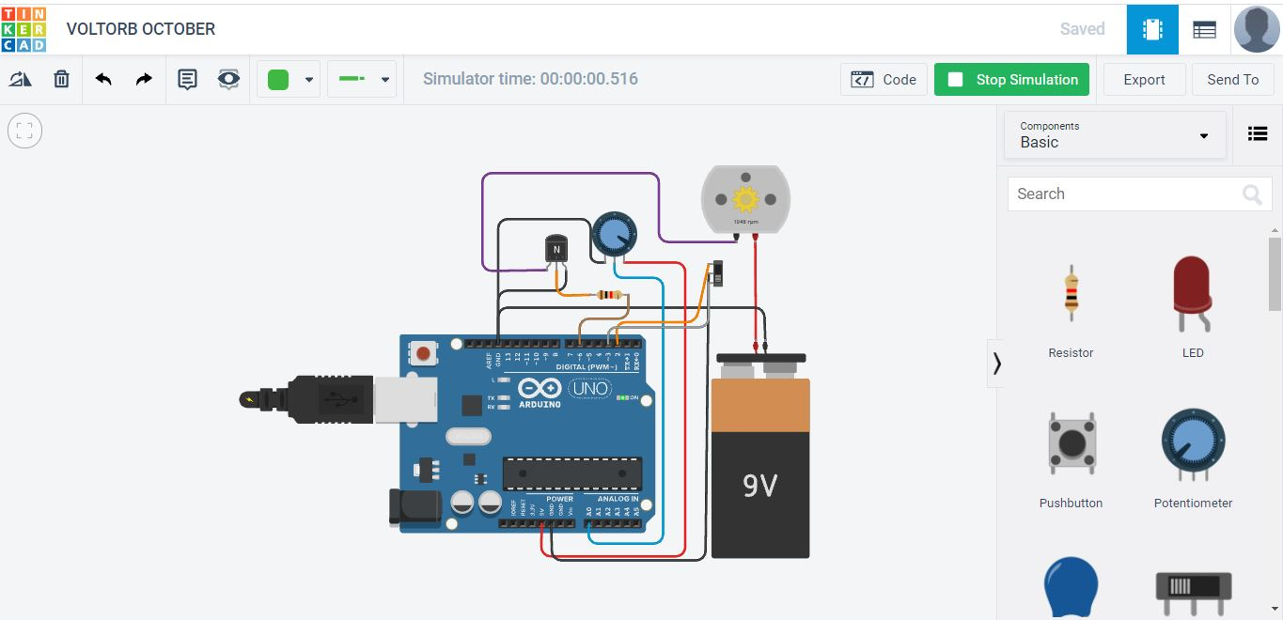
Simulation
To simulate this project, you may use some of the Easy to Learn -User Friendly & Free to Use applications like Tinkercad.

Slide 8
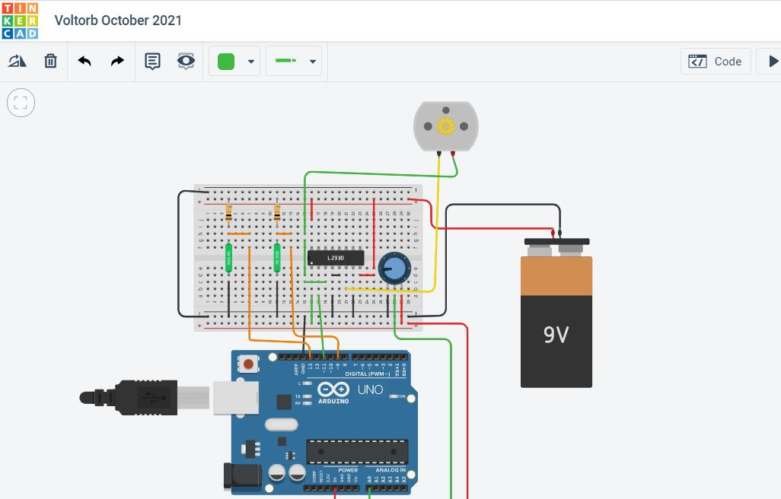
This is how the circuit is expected to look like

Slide 9



THANK
YOU
IEEE UVCE Power & Energy Society
ieee.uvce.pes
ieeeuvcepes
IEEE UVCE PES

